Slide 1
Introduction:
Multitasking:
Executing several tasks simultaneously is the concept of multitasking.
There are two types of multitasking .
Process based multitasking
Thread based Multitasking
Process based multitasking :
Executing several task simultaneously where each task is separate independent program(Process) is called process based multitasking
e.g. while typing java program in the editor we can listen audio songs from same system at the same time we can download a file from net . All these tasks will be executed simultaneously and independent of each other . Hence , it is process based multitasking .
Process based multitasking is best suitable at os level .
II .Thread based multitasking :
Executing several task simultaneously where each task is a separate independent part of the same program is called thread based multitasking and each independent part is called a thread .
Thread based multitasking is best suitable at programmatic level .

Slide 2
Main advantage of Multitasking :
Whether it is process based or thread based the main objective of multitasking is to reduce response time of the system to improve the performance .
The main important application areas of multithreading are :
To develop multimedia graphics
To develop animations.
To develop videogames .
To develop web servers and application servers etc..
When compared with old languages developing multithreaded application in java is very easy because java provides inbuilt support for multithreading with rich API (Thread , Runnable , ThreadGroup …. )
A Thread is lightweight code and each thread has a separate flow of execution. each threads has a separate job to be xecuted.

Slide 3
What is thread ?
We can define a thread in the following two ways :
By extending thread class
By implementing Runnable interface
By Extending Thread Class:

Slide 4
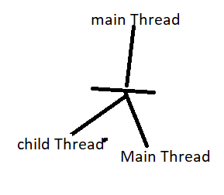
Example :
class MyThread extends Thread{
public void run(){
for(int i = 0;i<10;i++)
System.out.println("Child Thread");
// Executed by child Thread == job of Thread
}
}
class ThreadDemo{
public static void main(String[] args){
MyThread t = new MyThread(); // Thread Instantiation
t.start(); // Starting of a thread
for(int i = 0;i<10;i++)
System.out.println("Main Thread :");
// Executed by main Thread
}
}

Slide 5
Thread Scheduler:
It is the part of JVM . It is responsible to schedule threads ie. If multiple threads are waiting to get the chance of execution then in which order threads will be executed is decided by thread scheduler .
We can’t expect exact algorithm followed by thread scheduler it is varied from jvm to jvm . Hence we can’t expect threads execution order and exact output . Hence whenever situation comes to multithreading there is no guarantee for exact output . But we can provide several possible outputs .
P-1

Slide 6
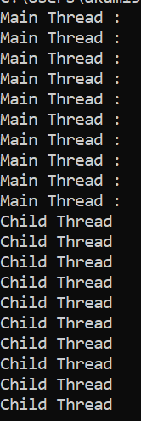
The Following are various possible output for the above program
Child Thread Child Thread Child Thread - - - - Main Thread Main Thread Main Thread - - - - | Main Thread Child Thread Main Thread Child Thread Main Thread Child Thread Main Thread Child Thread | Child Thread Main Thread Child Thread Main Thread -- -- - - - Child Thread Main Thread Child Thread Main Thread

Slide 7
Difference between t.start() and t.run();
In the case of t.start() a new thread will be created which is responsible for the execution of run method . But , In the case of t.run() a new thread won’t be created and run method will be executed just like a normal method by main thread Hence in the above program if we replace the t.start with t.run () then the output is :
Child Thread
Child Thread
Child Thread
== 10 times
Main Thread
Main Thread
--- 10 times
This total output produced by only main thread .

Slide 8
Case # 3 :
Importance of Thread class start method
Thread class method is responsible to register the thread with thread scheduler and all other mandatory activities . Hence, without executing thread class start() method there is no chance of starting a new thread in java . Due to This thread class method is considered as heart of multithreading .
Start(){
Register this thread with thread scheduler.
Perform all other mandatory activities.
Invoke run() method .
}
Case# 4 :
OverLoading of run() method :
Overloading of run method is always possible .But, Thread class start() method can invoke no-arg run() method the other overloaded method we have to call explicitly like a normal method call .

Slide 9
Case#4 Example
class MyThread extends Thread{
public void run(){
System.out.println("no-arg- run");
}
public void run(int i){
System.out.println("int-arg run ");
}
}
class Test{
public static void main(String[] args){
MyThread t = new MyThread(); // Thread Instantiation
t.start(); // Starting of a thread
}
}
// output : no-arg run

Slide 10
Case#5
If we are not overriding run() method :
Then Thread class run method will be executed which has empty implementation Hence we won’t get any output .
Example :
class MyThread extends Thread{
}
class Test{
public static void main(String[] args){
MyThread t = new MyThread(); // Thread Instantiation
t.start(); // Starting of a thread
}
}
Output : no output
Note
It is highly recommended to override run method otherwise don’t go for multithreading concept .

Slide 11
Case# 6 Overriding of start() method :
If we override start() method then our start method will be executed just like a normal method call and new thread won’t be created.
Example :
class MyThread extends Thread{
public void start(){
System.out.println("Start Method: ");
}
public void run(){
System.out.println("run Method");
}
}
class Test{
public static void main(String[] args){
MyThread t = new MyThread(); // Thread Instantiation
t.start(); // Starting of a thread
System.out.println("Main Method");
}
}
This output is produced by only main thread .
Output : start Method
Main Method

Slide 12
It is not recommended to override start method otherwise don’t go for multithreading concept.
Case#7
Output : class MyThread extends Thread{
public void start(){
super.start();
System.out.println("Start Method: ");
}
public void run(){
System.out.println("run Method");
}
}
class Test{
public static void main(String[] args){
MyThread t = new MyThread(); // Thread Instantiation
t.start(); // Starting of a thread
System.out.println("Main Method");
}
}
Possible output :
P1 Run method Start method Main method | P2 Start method Main method Run method | P3 Start method Run method Main method

Slide 13
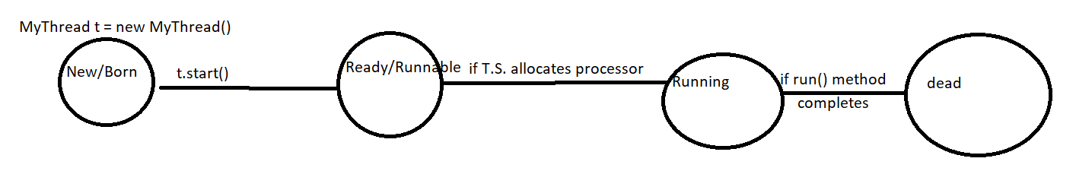
Case#8 Thread Lifecycle:
Case#9
After starting a thread if we are trying to restart the same thread then we will get Runtime Exception saying Illegal Thread State Exception .
Thred t = new Thread();
t.start();
-
-
-
t.start();
RE: IllegalThreadStateException

Slide 14
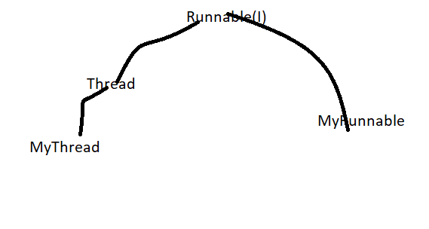
Defining a thread by implementing Runnable Interface:
We can define a thread by implementing Runnable Interface :
Runnable interface present in java.lang package and it contains only one method ie. Run() method
Example :
class MyRunnable implements Runnable{
public void run(){
for(int i = 0; i<10;i++){
System.out.println("Child Thread"); Executed by child thread // job of thread
}
}
}
class ThreadDemo {
public static void main(String[] args){
MyRunnable r = new MyRunnable();
Thread t = new Thread(r); // r: Target Runnable
t.start();
for(int i = 0;i<10;i++){
System.out.println("Main Thread"); Executed by main thread
}
}
}

Slide 15
We will get mixed output and we can’t tell exact output .
Case Study:
MyRunnable r = new MyRunnable();
Thread t1 = new Thread();
Thread t2 = new Thread();
Case1: t1.start()
A new thread will be created and which is responsible for the execution of thread class run method , which has empty implementation .
Case2: t1.run()
No new thread will be created and thread class run method will be excuted just like a normal method call
Case3: t2.start():
A new thread will be created which is responsible for the execution of MyRunnable class run method
Case 4 : t2.run()
A new thread won’t be created and MyRunnable run Method will be executed just like a normal method call .
Case5 : r.start()
We will get compile time error saying MyRunnable class doesn’t have start capability : RE : can not find symbol : method start(), location MyRunnable

Slide 16
Case6: r.run():
No new thread will be created and MyRunnable run() method will be executed like normal method call .
Which approach is best to define a thread ?
Among two ways of defining a thread implements Runnable approach is recommended .
In the first approach our class always extends thread class, there is no chance of extending any other class Hence, we are missing inheritance benefits .
But in the second approach while implementing Runnable interface we can extend any other class hence we won’t miss any inheritance benefits .
Because of above reason implementing runnable interface approach is recommended then extending thread class .

Slide 17
Thread class Constructors
1. Thread t = new Thread();
2. Thread t = new Thread(Runnable r);
3. Thread t = new Thread(String name);
4. Thread t = new Thread(Runnable r , String name);
5. Thread t = new Thread(ThreadGroup g, Runnable r);
6. Thread t = new Thread(ThreadGroup g,String name);
7. Thread t = new Thread(ThreadGroup g, Runnable r, String name);
8. Thread t = new Thread(ThreadGroup g, Runnable r, String name, long stacksize);
Durga’s Approach to define a thread (not recommended to use):
class MyThread extends Thread{
public void run(){
System.out.println("Child Thread");
}
}
class ThreadDemo {
public static void main(String[] args){
MyThread t = new MyThread();
Thread t1 = new Thread(t); // r: Target Runnable
t1.start();
}
}

Slide 18

Output : //child Thread
Main Thread
Main Thread
Child Thread
Getting and setting name of a thread
Every thread in java has some name it may be default name generated by jvm or customized name provided by programmer .
We can get and set name of a thread by using the following two methods of thread class.
Public final String getName()
Public final void setName(String Name ):
Example:
class MyThread extends Thread{
}
class Test{
public static void main(String[] args){
System.out.println(Thread.currentThread().getName());
MyThread t = new MyThread();
System.out.println(t.getName());
Thread.currentThread().setName("Akhil's Thread");
System.out.println(Thread.currentThread().getName());
}
}

Slide 19

Example :
class MyThread extends Thread{
public void run(){
System.out.println(“run method is executed by : "+Thread.currentThread().getName());
}
}
class Test{
public static void main(String[] args){
MyThread t = new MyThread();
t.start();
System.out.println(“Main is executed by Thread : "+Thread.currentThread().getName());
}
}
Note
We can get current executing thread object by using Thread.currentThread() method .

Slide 20
Thread Priorities :
Every thread in java has some priority it may be default priority generated by jvm or customized priority provided by programmer the valid range of thread priorities is (1 to 10 ) where 1 is min priority and 10 is max priority . Thread class defines the following constants to represent some standard priorities .
Thread.MIN_PRIORITY === 1
Thread.NORM_PRIORITY === 5
Thread.MAX_PRIORITY === 10
Thread Scheduler will use priorities while allocating the processor the thread which is having the highest priority will get the chance first.
If two threads having same priority then we can’t expect exact execution order. It depends on thread scheduler .
Setting and Getting thread Priority
Thread class defines the following methods to get and set priority of a thread.
public final int getPriority();
public final void setPriority(int p);
Allowed values range 1 to 10 otherwise RuntimeException : IllegalArgumentException.
Example:
t.setPriority(7); // Valid
t.setPriority(17); IllegalArgumentException .

Slide 21
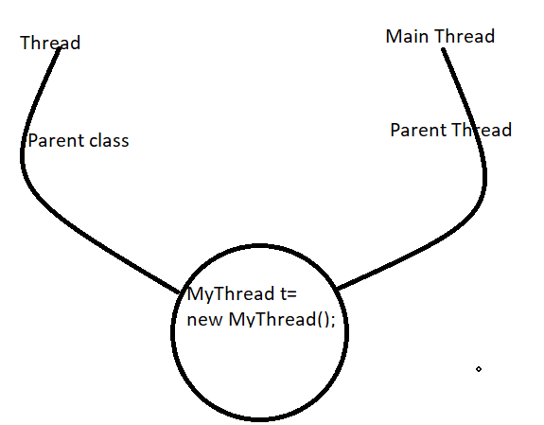
Default Priority
The default priority only for the main thread is 5 .But for all remaining thread default priority will be inherited from parent to child. i.e Whatever priority parent thread have the same priority will be there for the child thread.
For Example:
class MyThread extends Thread{
}
class Test{
public static void main(String[] args){
System.out.println(Thread.currentThread().getPriority());
//Thread.currentThread().setPriority(15);
//Thread.currentThread().setPriority(7);
MyThread t = new MyThread();
System.out.println(t.getPriority());
}
}
If we comment line three then child thread priority will become 5

Slide 22
class MyThread extends Thread{
public void run(){
for(int i = 0; i<10;i++)
System.out.println("child Thread");
}
}
class ThreadPriorityDemo{
public static void main(String[] args){
MyThread t = new MyThread();
t.setPriority(10); // 1
t.start();
for(int i = 0; i<10;i++)
System.out.println("Main Thread");
}
}
If we are commenting line 1 then both main and child thread have the same priority 5 and hence we can’t expect execution order and exact output . If we are not commenting line then main thread has a priority 5 . And Child thread has a priority 10 . Hence child thread will get the chance first followed by main thread . In this case output is
Note :
Some platforms won’t provide proper support for thread priorities.

Slide 23
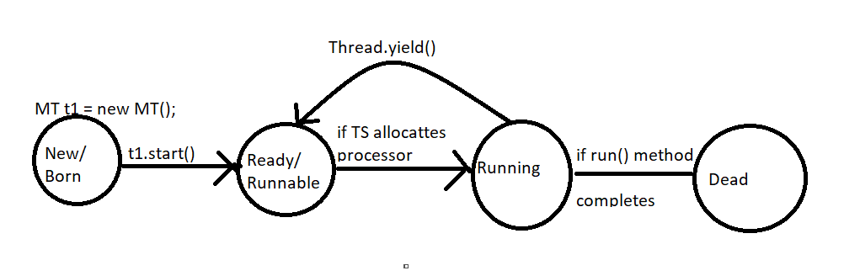
Prevent Thread Execution :
We can prevent a thread execution by following methods:
Yield() method
Join() method
Sleep() method .
Yield() Method :
Yield method causes to pause current executing thread to give the chance for waiting threads of same priority .
If there is no waiting thread or all waiting thread have low priority then same thread can continue its execution.
If multiple threads are waiting with the same priority . Then which waiting thread will get the chance we can’t expect it depends on thread scheduler .
The Thread which is yielded , when it will get the chance again it depends on Thread Scheduler and we can’t expect exactly .
public static native void yield();

Slide 24
class MyThread extends Thread{
public void run(){
for(int i = 0; i<10;i++){
System.out.println("child Thread");
Thread.yield(); // 1
}
}
}
class ThreadYieldDemo{
public static void main(String[] args){
MyThread t = new MyThread();
t.start();
for(int i = 0; i<10;i++){
System.out.println("Main Thread");
}
}
}
In the above program if we are commenting line 1 then both threads will be executed simultaneously and we can’t expect which thread will complete first .
If we are not commenting line 1 then child thread always calls yield method because of that main thread will get chance more number of times and the chance of completing main thread first is high .

Slide 25
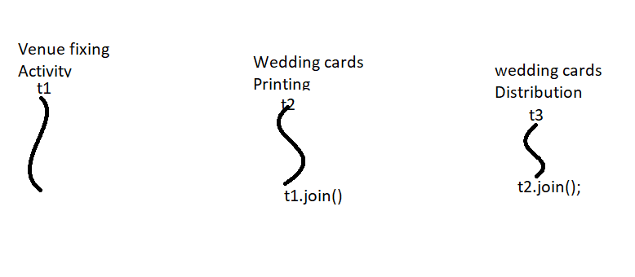
Some platforms won’t provide proper support for yield method.
Join Method:
If a thread wants to wait until completing some other thread then we should go for join method . For example if a thread t1 wants to wait until completing t2 then t1 has to call (t2.join())
If t1 executes t2.join(); then immediately t1 will be entered into waiting state until t2 completes .
Once t2 completes then t1 can continue its execution .
Wedding cards printing thread(t2) has to wait until venue fixing thread completion Hence t2 has to call t1.join()
Wedding cards distribution thread(t3) has to wait until wedding cards printing thread(t2) completion Hence t3 has to call t2.join();

Slide 26
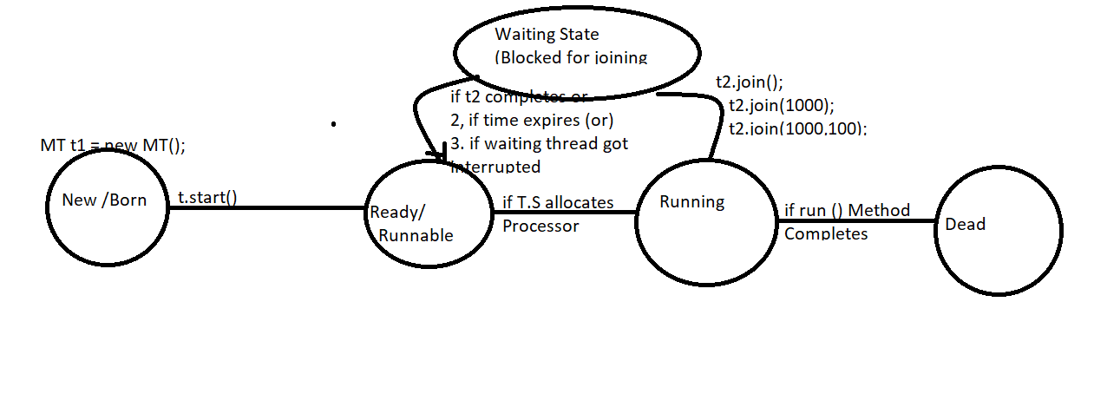
public final void join()throws InterruptedException ;
public final void join(long ms) throws InterruptedException ;
public final void join(long ms, int ns) throws InterruptedException ;
Note
Every join method throws IterruptedException which is checked Exception Hence compulsory we should handle this exception either by using try catch or by using throws keyword otherwise we will get compiletime error

Slide 27
class MyThread extends Thread{
public void run(){
for(int i = 0; i<10;i++){
System.out.println("Neelam Thread ");
try{
Thread.sleep(2000);
}catch(InterruptedException e){
e.printStackTrace();
}
}
}
}
class ThreadJoinDemo{
public static void main(String[] args)throws InterruptedException{
MyThread t = new MyThread();
t.start();
t.join(); // t.join(10000); // line 1
for(int i = 0; i<10;i++){
System.out.println("Ram Thread");
}
}
}

Slide 28
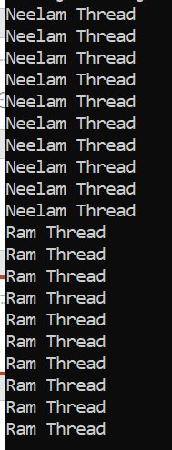
Case I.
In above example we can see waiting of main Thread until completing child thread .
If we comment line 1 then both main and child threads will be executed simultaneously and we can’t expect exact output
If we are not commenting line 1 then main thread calls join method on child thread object Hence main thread will wait until completion of child thread :
Case2
Waiting of child Thread until completing main thread .
In the below example child thread calls join method on main thread object Hence child thread has to wait until
Completing main thread In this case the output is
Main Thread
--------
--- 10 times
Child Thread
--
----
10 times

Slide 29
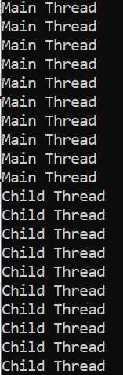
class MyThread extends Thread{
static Thread mt;
public void run(){
try{
mt.join();
}catch(InterruptedException e){
e.printStackTrace();
}
for(int i = 0;i<10;i++){
System.out.println("Child Thread ");
}
}
}
class ThreadJoinDemo{
public static void main(String[] args)throws InterruptedException{
MyThread.mt = Thread.currentThread();
MyThread t = new MyThread();
t.start();
for(int i = 0;i<10;i++){
System.out.println("Main Thread ");
Thread.sleep(2000);
}
}
}

Slide 30
Case 3
If main thread calls join method on child thread object and child thread calls join method on main thread object then both thread will wait forever . And the program will be stucked this is something like Deadlock
Case 4
class Test{
public static void main(String[] args)throws InterruptedException{
Thread.currentThread().join();
}
}
If a Thread calls join method on the same thread itself then the program will be stucked this is something like deadlock. In this case thread has to wait infinite amount of time

Slide 31
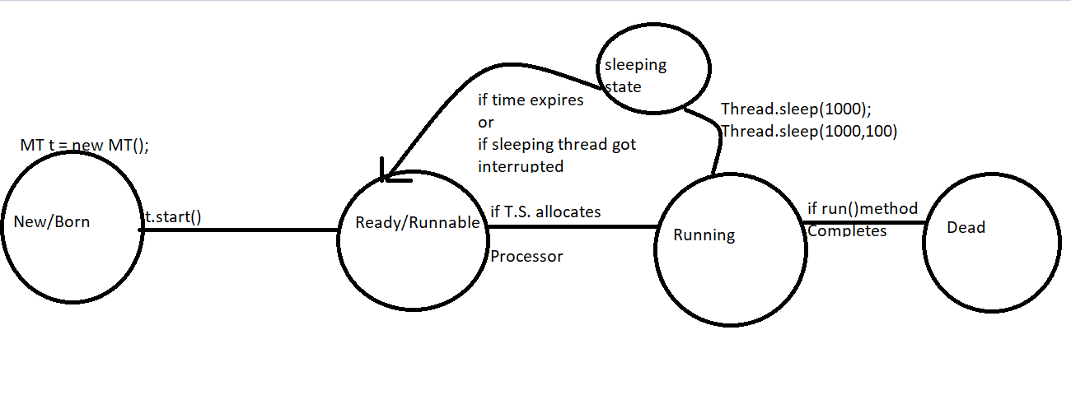
Sleep() Method :
If a thread don’t want to perform any operation for a particular amount of time then we should go for sleep method
public static native void sleep(long ms) throws InterruptedException;
public static void sleep(long ms, int ns) throws InterruptedException;
Every sleep method throws InterruptedException , Which is checked Exceptoin Hence whenever we are using sleep() method compulsory we should handle InterruptedException either by try catch or by throws keyword . Otherwise we will get compiletime error.

Slide 32
class SlideRotator{
public static void main(String[] args)throws InterruptedException{
for(int i = 0;i<10;i++){
System.out.println("Slide-"+i);
Thread.sleep(5000);
}
}
}
How a thread can Interrupt another Thread?
A thread can interrupt a sleeping thread or waiting thread by using interrupt method of thread class
public void interrupt();

Slide 33

class MyThread extends Thread{
public void run(){
try{
for(int i = 0;i<10;i++){
System.out.println("I am Lazy Thread ");
Thread.sleep(2000);
}
}catch(InterruptedException e){
System.out.println("I got Interrupted !!");
}
}
}
class ThreadInterruptDemo{
public static void main(String[] args){
MyThread t = new MyThread();
t.start();
t.interrupt(); // line 1
System.out.println("End of Main");
}
}
If we comment line then main thread won’t interrupt child thread .In this case child thread will execute for loop 10 times
If we are not commenting line then main thread interrupts child thread in this case the output Is

Slide 34
Note**
Whenever we are calling interrupt method if the target thread not in sleeping or waiting state then there is no impact of interrupt call immediately interrupt call will be waited until target thread entered into sleeping or waiting state .
If the target thread entered into sleeping or waiting state then immediately interrupt call will interrupt the target thread .
If the target thread never entered into sleeping or waiting state in its life time then there is no impact of interrupt call. This is the only case where interrupt call will be wasted
In the below example interrupt call waited until child thread completes for loop 1000 times

Slide 35
class MyThread extends Thread{
public void run(){
for(int i = 0;i<1000;i++){
System.out.println("I am Lazy Thread- "+i);
}
System.out.println("I want to sleep ");
try{
Thread.sleep(1000);
}catch(InterruptedException e){
System.out.println("I got Interrupted !!");
}
}
}
class ThreadInterruptDemo1{
public static void main(String[] args){
MyThread t = new MyThread();
t.start();
t.interrupt();
System.out.println("End of Main");
}
}

Slide 36
Comparison table of yield() join() and sleep() method
Property | Yield() | Join() | Sleep()
purpose | If a thread wants to pause its execution to give the chance for remaining threads of same priority then we should go for yield method | If a thread wants to wait until completing some other thread then we should go for join method | If a thread don’t want to perform any operation for a particular amount of time then we should go for sleep method
Is it overloaded | No | Yes | Yes
Is it final | No | Yes | No
Is it throws IE | No | Yes | Yes
Is it Native | yes | No | Sleep(long ms)== native Sleep(long ms,int ns) == non-native
Is it static | Yes | No | Yes

